Slide 1
Dynamic Programming
Day 4
- Priyansh Agarwal
-Priyansh Agarwal

Slide 2
Solving Homework Problems

Slide 3
Problem 1: Link
State:
dp[i][j] = edit distance b/w string A[i:n] and B[j:m]
Transition:
dp[i][j] = (a[i] == b[j]) ? dp[i + 1][j + 1] : 1 + min(dp[i][j + 1], dp[i + 1][j], dp[i + 1][j + 1])
Base Case:
dp[n][j] = m - j, dp[i][m] = n - i
Final Subproblem:
dp[0][0]

Slide 4
Problem 2: Link
State:
dp[i][j] = min cuts to make rectangle of (i * j) into squares
Transition:
dp[i][j] = min(1 + min(dp[i][k] + dp[i][j - k]), 1 + min(dp[k][j] + dp[i - k][j]))
Base Case:
dp[i][i] = 0
Final Subproblem:
dp[n][m]

Slide 5
Problem 3: Link
State:
dp[i] = set of sums possible with coins from 1 to i^{th} coin
Transition:
dp[i] => add or not add the current coin to all the sums possible in the previous state
Base Case:
dp[0] = {0}
Final Subproblem:
dp[n]

Slide 6
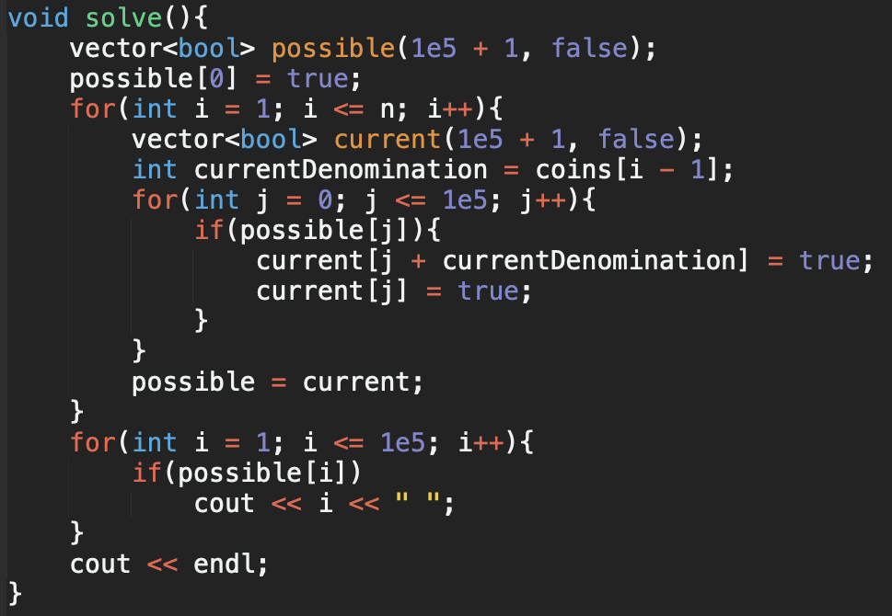
Problem 3: Link

Slide 7
Answer Construction
Grid problem: Find the actual path with the minimum sum.
Minimizing coins problem: Find the actual choice of coins.
At every state we are making some optimal choice.
If we store this choice, we can be sure that if we are at any state we know what is the best choice.
Start from the state that contains your final subproblem and keep making the best choice (which was already stored) until you reach the end.

Slide 8
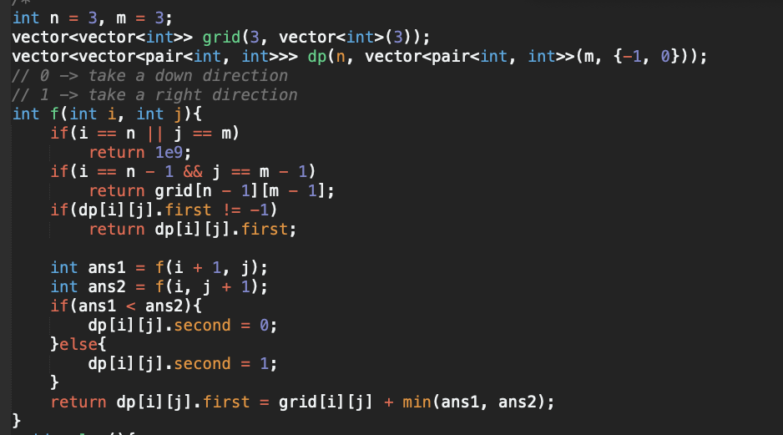
Answer Construction - Grid Problem

Slide 9
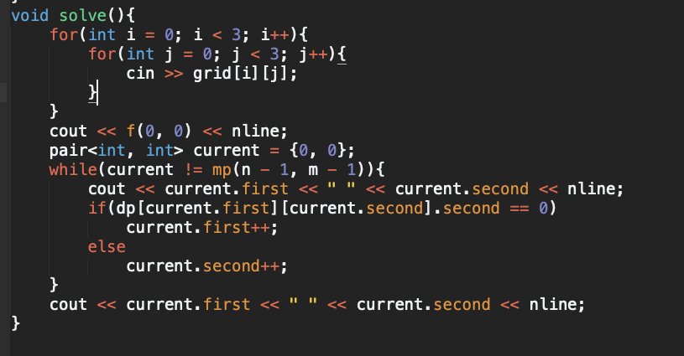
Answer Construction - Grid Problem

Slide 10
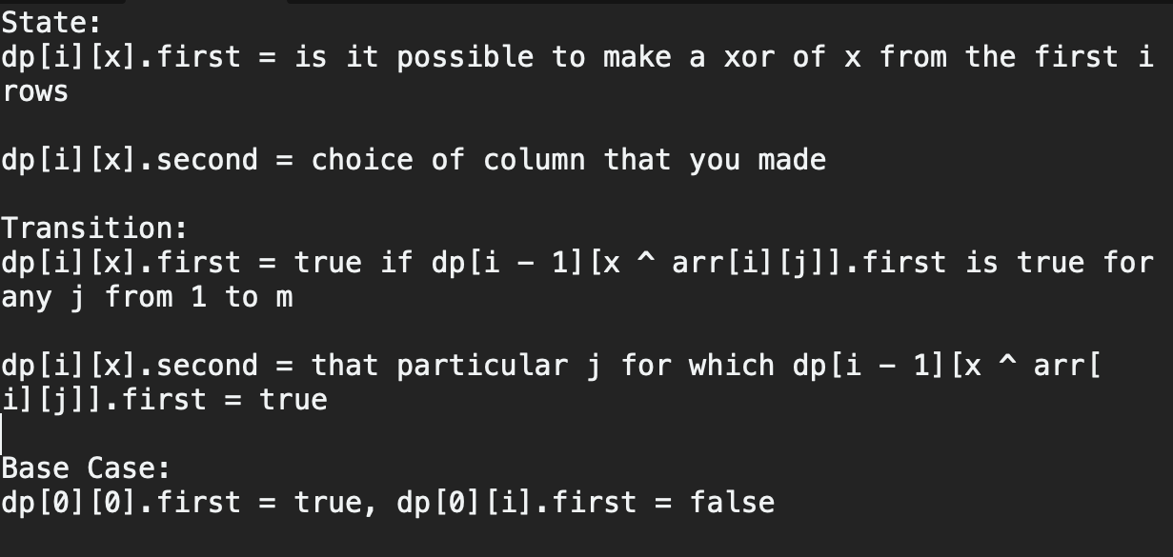
Non Standard Problem 1: Link

Slide 11
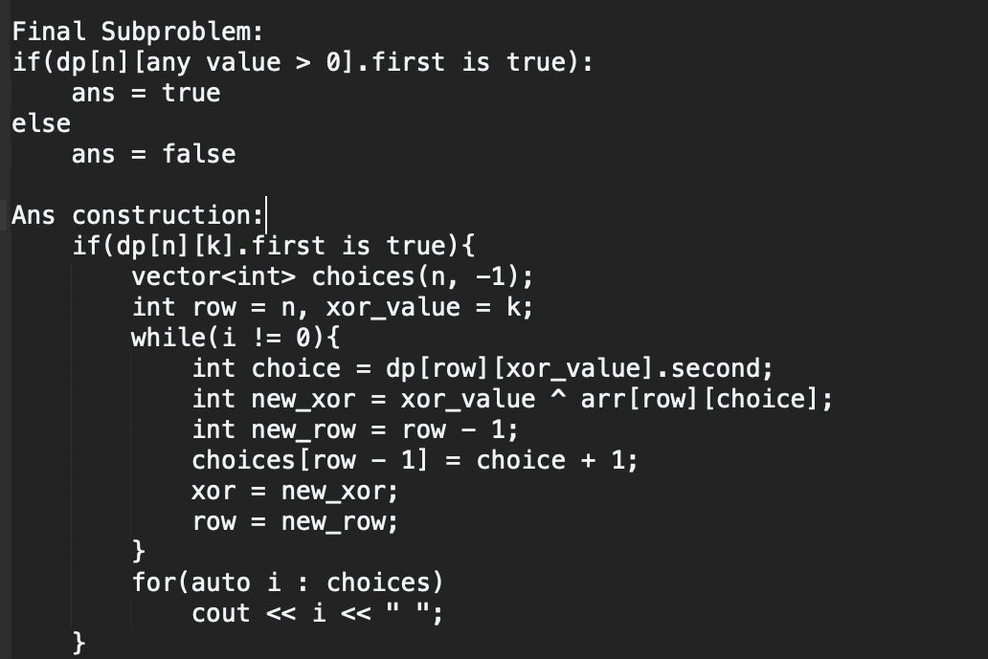
Non Standard Problem 1: Link

Slide 12
Representing non-integer parameters
How will you store the dp states if instead of integer parameters you had a string or a vector or a map or any complex data type?
Use a map instead of an array.
Tradeoff map<pair<int, string>> DP or vector<map<string>> DP

Slide 13
Non Standard Problem 2: Link (HW)
State:
Transition:
Base Case:
Final Subproblem:

